Slide 1
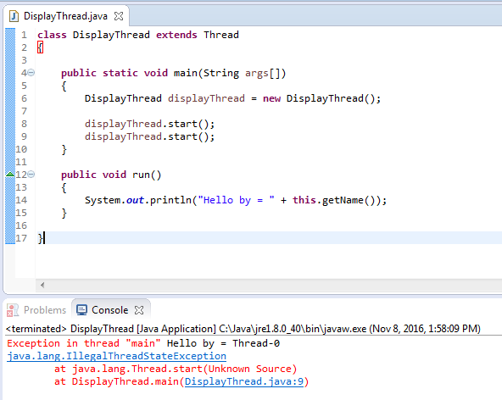
Can we start a thread twice?
We can’t start a thread twice. After starting a thread, it can never be started again. If you does so, an IllegalThreadStateException is thrown. In such case, thread will run once but for second time, it will throw exception.

